Slide 1

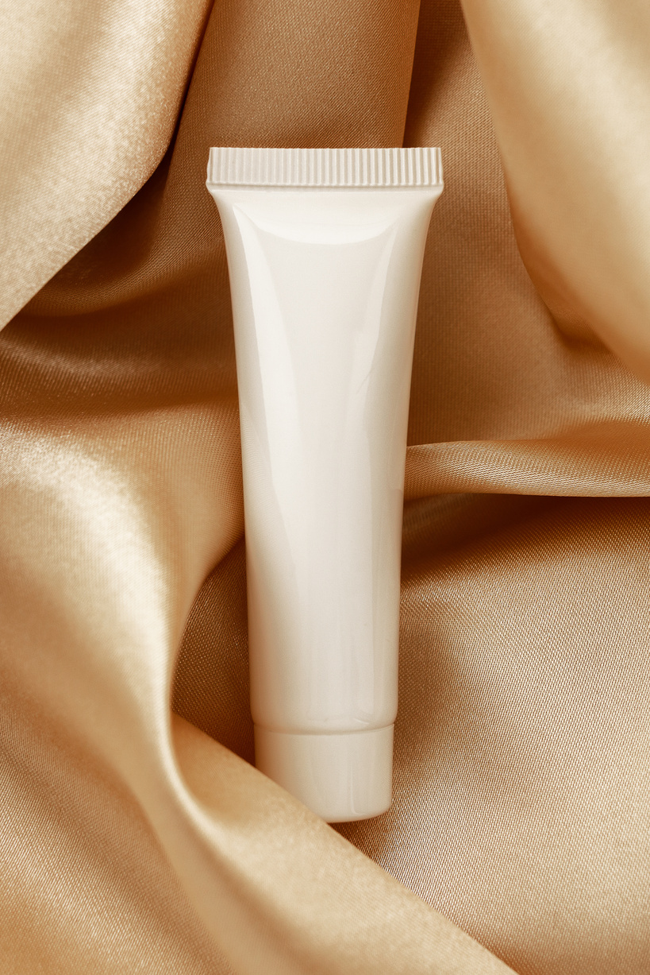

Product
Review
I love using these products. There is no sticky feeling after applying the lotion. Now I can use this daily and benefit from it.
Olivia Wilson

